Slide 1
Interim Report Q2 2024
Stable quarter in soft market
Robert Dackeskog, President and CEO Magnus Carlsson, CFO

Slide 2
Disclaimer
This presentation has been prepared by Duni AB (the “Company”) solely for use at this investor presentation and is furnished to you solely for your information and may not be reproduced or redistributed, in whole or in part, to any other person. By attending the meeting where this presentation is made, or by reading the presentation slides, you agree to be bound by the following limitations.
The Information has been prepared solely for information purposes. The information does not constitute investment advice and does not form part of, and should not be construed as, an offer or the solicitation of an offer to subscribe for or purchase securities of the Company. Nothing contained therein shall form the basis of or be relied on in connection with any contract or commitment whatsoever.
This presentation is not for presentation or transmission into the United States or to any U.S. person, as that term is defined under Regulation S promulgated under the Securities Act of 1933, as amended.
This presentation contains various forward-looking statements that reflect management’s current views with respect to future events and financial and operational performance. The words “believe,” “expect,” “anticipate,” “intend,” “may,” “plan,” “estimate,” “should,” “could,” “aim,” “target,” “might,” or, in each case, their negative, or similar expressions identify certain of these forward-looking statements. Others can be identified from the context in which the statements are made. These forward-looking statements involve known and unknown risks, uncertainties and other factors, which are in some cases beyond the Company’s control and may cause actual results or performance to differ materially from those expressed or implied from such forward-looking statements. These risks include but are not limited to the Company’s ability to operate profitably, maintain its competitive position, to promote and improve its reputation and the awareness of the brands in its portfolio, to successfully operate its growth strategy and the impact of changes in pricing policies, political and regulatory developments in the markets in which the Company operates, and other risks.
The information and opinions contained in this document are provided as at the date of this presentation and are subject to change without notice, except as required by applicable law, the Company does not assume any responsibility or obligation to update publicly or review any of the forward-looking statements contained in it and nor does it intend to.
No representation or warranty (expressed or implied) is made as to, and no reliance should be placed on, the fairness, accuracy or completeness of the information contained herein. Accordingly, none of the Company, or any of its principal shareholders or subsidiary undertakings or any of such person’s officers or employees accepts any liability whatsoever arising directly or indirectly from the use of this document.

Slide 3
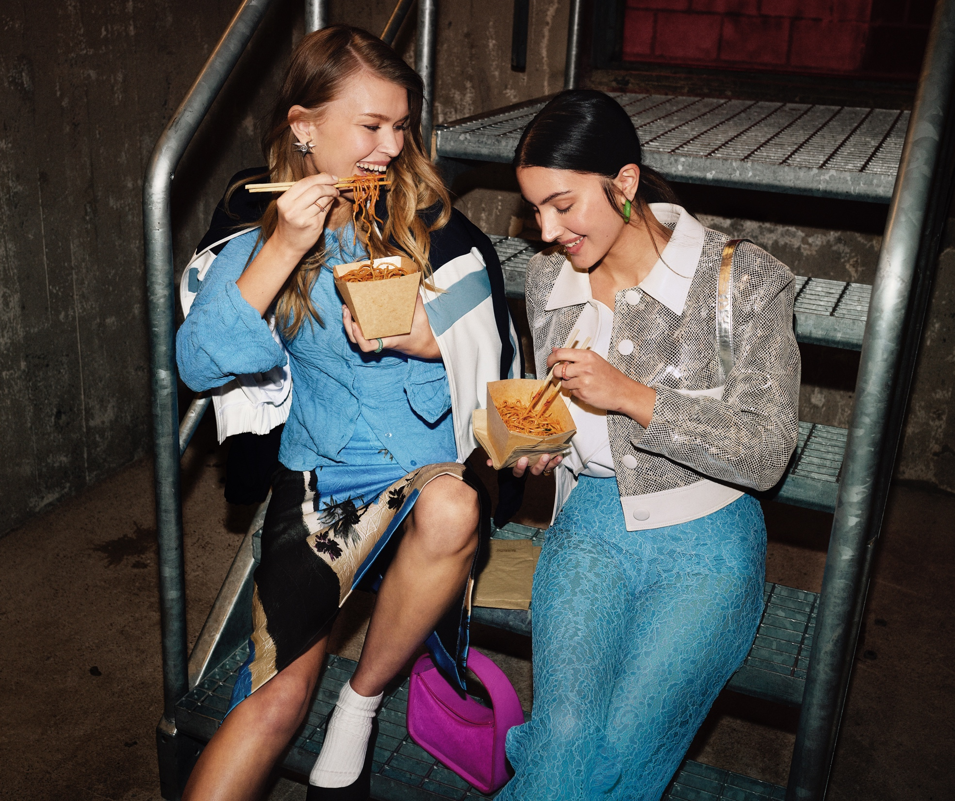
Agenda
Highlights
Market outlook
Q2 summary
Business areas
Innovations
Sustainability
Financials
Summary
Q&A
3

Slide 4
Highlights
Soft market with mixed development signals
Net sales and profit second best Q2 in Company history, next to particularly high Q2 2023
Strong financial position
4

Slide 5
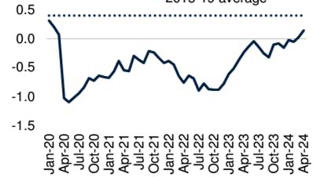
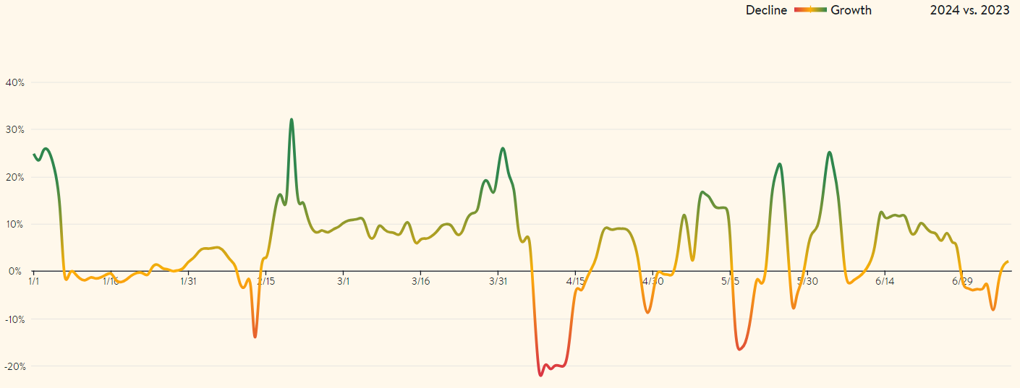
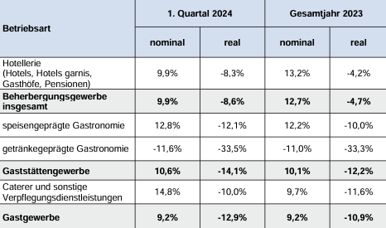
Market Outlook
Global consumer confidence
The HoReCa market will continue to have a gradual and potentially volatile recovery short-term and a stable recovery long-term. Mixed signals and uncertainty for the coming quarters.
Duni Group’s complementary business areas with a diversified product portfolio provides resilience.
The Group’s good financial position enables addressing profitable long-term growth opportunities.
Source: https://www.worldbank.org/en/publication/global-economic-prospects
Open table Germany
Sales development Hospitality Germany, vs. pre-pandemic
Source: https://www.opentable.com/state-of-industry
*Data for Germany
Source: Statistisches Budesamt

Slide 6
Q2 2024 Key Financials
NET SALES
OPERATING INCOME
OPERATING MARGIN
SEK 1,875 m
SEK 135 m
7.2%
Net sales amounted to SEK 1,875 m (1,936)
Operating income amounted to SEK 135 m (170)
Operating margin was 7.2% (8.8)

Slide 7
Q2 Comments
NET SALES -3.1%
OPERATING INCOME -20.8%
General decrease in most markets and product categories as sales reached record levels in comparison period
Selective price decreases implemented last year decreased sales
Sales through the retail channel recovers from slow Q1 while sales to hotel and restaurant industry decreases
Inconclusive market data signaling both positive and negative development and outlook
Second highest Q2 in the Group’s history, but lower than last year
LY Government support of 20 msek, price decreases and lower turnover within Business Area Dining Solutions leading to decrease in Operating Income
Increasing raw material and cost for sea freight puts further pressure on the quarterly result
Newly acquired Decent Packaging and Huskee contributes with positive results to the operating income while innovative startup Relevo lowers Duni Group’s result

Slide 8
BA Dining Solutions
NET SALES
OPERATING INCOME
OPERATING MARGIN
SEK 1,069 m
SEK 93 m
8.7%
Net sales amounted to
SEK 1,069 m (1,148)
Operating income amounted to
SEK 93 m (134)
Operating margin was
8.7% (11.6)

Slide 9
Dining Solutions Q2 2024
General decrease in demand from HoReCa market resulting in lower volumes
Sales towards Retail in line with last year, recovering from Q1s lower volumes, but still very volatile
Price decreases lower the turnover, but secures relevance in tender business
Lower volumes means less fixed cost coverage in the vertically integrated factories
Rising raw material costs puts gradually increasing pressure on operating income during the quarter

Slide 10
BA Food Packaging Solutions
NET SALES
OPERATING INCOME
OPERATING MARGIN
SEK 806 m
SEK 42 m
5.1%
Net Sales amounted to
SEK 806 m (788)
Operating Income
SEK 42 m (36)
Operating Margin was
5.1% (4.6)

Slide 11
Food Packaging Solutions Q2 2024
Net growth with increasing volumes outside of Europe while volumes in Europe decrease as demand weakens
Price decreases implemented during previous year lower sales
Cost for sea freight increases during the quarter
Operating Income improvement derived from more efficient inventory in Europe, while challenging storage cost in APAC due to high stock levels
Launch of innovative lid for take-away cups, Liplid

Slide 12
Trusted Sustainability Leader in our Industry
Engaging in sustainable and circular innovations
LAB
COOPERATIONS
PARTNERSHIPS
STARTUP PROJECTS
(minority investments)
Bio Dunisoft®
OrganoClick
Bûmerang
Relevo
Bio Dunicel®
Bower
Unmo
BicyCompost
Notpla
Liplid

Slide 13
Our Decade of Action 2030
Our sustainability initiatives
BECOMING CIRCULAR AT SCALE
GOING NET ZERO
LIVING THE CHANGE
100%
0 CO2
#1
Circular target
Net Zero carbon emissions for Scope 1 and 2
A trusted sustainability leader

Slide 14
Becoming Circular at Scale
Going Net Zero
Living the Change
ACTIVITIES IN THE QUARTER
ACTIVITIES IN THE QUARTER
ACTIVITIES IN THE QUARTER
Collaboration with Liplid on non-added PFAS lids for cups
Collaboration with Notpla on renewable take-away products
New and more efficient production equipment installation at the Group’s paper mill
Started certification of CO2 calculator for packaging products
Recognized by Environmental Packaging Award for bagasse products
The business in Poland received an award for its internal sustainability campaign
Use of virgin fossil plastic for single-use items
KPI: Reduction by 50% by 2025 compared to 2019 as a base year
Progress: Fossil plastic use index at 64 by the end of Q2 2024 (reduction by 36%)
Scope 1+2 carbon intensity
KPI: Reach index 38 by end of 2024 compared to 2019 as base year
Progress: Carbon intensity reached index 40 by the end of Q2 2024 (reduction by 60%)
Ecovadis score:
KPI: EcoVadis Platinum level by 2025 (full-year result)
Progress: EcoVadis score 77 (top 2%) for 2023 (Gold level)
14

Slide 15
Financials

Slide 16
Income Statement
SEK m | Q2 / 2024 | Q2 / 2023 | YTD / 2024 | YTD / 2023 | LTM / 2023-24 | FY / 2023
Net sales | 1,875 | 1,936 | 3,611 | 3,813 | 7,517 | 7,718
Gross profit | 453 | 440 | 888 | 831 | 1,903 | 1,846
Gross margin | 24.1% | 22.7% | 24.6% | 21.8% | 25.3% | 23.9%
Selling expenses | -191 | -171 | -378 | -332 | -745 | -699
Administrative expenses | -119 | -119 | -221 | -214 | -427 | -421
R & D expenses | -9 | -9 | -18 | -15 | -39 | -36
Other operating net | -18 | 13 | -33 | -5 | -71 | -42
EBIT | 116 | 154 | 238 | 265 | 621 | 648
Adjustments | -19 | -16 | -36 | -35 | -70 | -68
Operating income¹⁾ | 135 | 170 | 275 | 300 | 691 | 716
Operating margin | 7.2% | 8.8% | 7.6% | 7.9% | 9.2% | 9.3%
Financial net | -17 | -10 | -30 | -28 | -57 | -56
Taxes | -15 | -24 | -41 | -27 | -164 | -150
Net income | 84 | 120 | 168 | 211 | 400 | 443
Earnings per share, attributable to equity holders of the Parent Company | 1.72 | 2.20 | 3.38 | 3.86 | 7.83 | 8.30
¹⁾ Operating income adjusted for fair value allocations and amortization of intangible assets identified in connection with business acquisitions and for restructuring costs.

Slide 17
Business Area Financials
SEK m |  | Q2 / 2024 | Q2 / 2023 | YTD / 2024 | YTD / 2023 | LTM / 2023-24 | FY / 2023
Dining Solutions | Net sales Operating income¹⁾ Operating margin | 1,069 93 8.7% | 1,148 134 11.6% | 2,099 203 9.7% | 2,278 255 11.2% | 4,502 547 12.1% | 4,681 600 12.8%
Food Packaging Solutions | Net sales Operating income¹⁾ Operating margin | 806 42 5.1% | 788 36 4.6% | 1,512 72 4.8% | 1,535 45 2.9% | 3,014 144 4.8% | 3,037 117 3.8%
Duni Group | Net sales Operating income¹⁾ Operating margin | 1,875 135 7.2% | 1,936 170 8.8% | 3,611 275 7.6% | 3,813 300 7.9% | 7,517 691 9.2% | 7,718 716 9.3%
¹⁾ Operating income adjusted for fair value allocations and amortization of intangible assets identified in connection with business acquisitions and for restructuring costs.

Slide 18
Operating Cash Flow
SEK m | Q2 / 2024 | Q2 / 2023 | YTD / 2024 | YTD / 2023 | LTM / 2023-24 | FY / 2023
Operating EBITDA¹⁾ | 168 | 210 | 341 | 372 | 830 | 860
Capital expenditure | -41 | -18 | -67 | -37 | -185 | -157
Change in;
Inventory | -19 | 163 | -113 | 316 | 41 | 469
Accounts receivable | -53 | -15 | -14 | -69 | 60 | 5
Accounts payable | 29 | -41 | -107 | -260 | 33 | -120
Other operating working capital | -8 | 56 | -89 | 54 | -42 | 101
Change in working capital | -50 | 163 | -323 | 40 | 92 | 456
Operating cash flow²⁾ | 76 | 354 | -49 | 375 | 736 | 1,158
¹⁾ Operating EBITDA is EBITDA less restructuring costs and fair value allocations and effects from IFRS 16 Leases. ²⁾ Operating cash flow excludes changes in right-of-use assets and changes in leasing debts.

Slide 19
Financial Position
SEK m | June 2024 | December 2023 | June 2023
Goodwill | 2,306 | 2,110 | 2,160
Tangible and intangible fixed assets | 1,547 | 1,500 | 1,548
Net financial assets¹⁾ | 30 | -36 | 4
Inventories | 1,461 | 1,251 | 1,469
Accounts receivable | 1,188 | 1,125 | 1,259
Accounts payable | -649 | -719 | -601
Other operating assets and liabilities³⁾ | -721 | -651 | -699
Net assets | 5,162 | 4,580 | 5,142
Net debt | 1,058 | 598 | 1,274
Equity | 4,104 | 3,982 | 3,868
Equity and net debt | 5,162 | 4,580 | 5,142
ROCE²⁾ | 14% | 16% | 12%
ROCE²⁾ w/o Goodwill | 26% | 32% | 22%
Net debt / Equity | 26% | 15% | 33%
Net debt / EBITDA²⁾ | 1,18 | 0.65 | 1.56
¹⁾ Deferred tax assets and liabilities + Income tax receivables and payables.
²⁾ Operating income adjusted for fair value allocations and amortization of intangible assets identified in connection with business acquisitions and for restructuring costs. Calculated based on the last twelve months.
³⁾ Including restructuring provision and derivatives.

Slide 20
Financial Targets
SALES GROWTH
OPERATING MARGIN
DIVIDEND PAYOUT RATIO
> 5%
> 10%
40+%
Organic growth of 5% over a business cycle
Consider acquisitions to reach new markets or to strengthen current market positions.
Top line growth – premium focus
Improvements in manufacturing, sourcing and logistics.
Target at least 40% of net profit
LTM 2023/24
LTM 2023/24
2023
-5.0% at fixed exchange rates
9.2%
5.00 SEK (60%)

Slide 21
Summary Q2 2024
Soft market with mixed development signals
Net sales and profit second best Q2 in Company history, next to particularly high Q2 2023
Strong financial position
21

Slide 22
Thank you!

