Slide 1

Interim Report Q1 2024
Stronger Operating Income and Strategically niched acquisitions
Robert Dackeskog, President and CEO
Magnus Carlsson, CFO

Slide 2
Disclaimer
This presentation has been prepared by Duni AB (the “Company”) solely for use at this investor presentation and is furnished to you solely for your information and may not be reproduced or redistributed, in whole or in part, to any other person. By attending the meeting where this presentation is made, or by reading the presentation slides, you agree to be bound by the following limitations.
The Information has been prepared solely for information purposes. The information does not constitute investment advice and does not form part of, and should not be construed as, an offer or the solicitation of an offer to subscribe for or purchase securities of the Company. Nothing contained therein shall form the basis of or be relied on in connection with any contract or commitment whatsoever.
This presentation is not for presentation or transmission into the United States or to any U.S. person, as that term is defined under Regulation S promulgated under the Securities Act of 1933, as amended.
This presentation contains various forward-looking statements that reflect management’s current views with respect to future events and financial and operational performance. The words “believe,” “expect,” “anticipate,” “intend,” “may,” “plan,” “estimate,” “should,” “could,” “aim,” “target,” “might,” or, in each case, their negative, or similar expressions identify certain of these forward-looking statements. Others can be identified from the context in which the statements are made. These forward-looking statements involve known and unknown risks, uncertainties and other factors, which are in some cases beyond the Company’s control and may cause actual results or performance to differ materially from those expressed or implied from such forward-looking statements. These risks include but are not limited to the Company’s ability to operate profitably, maintain its competitive position, to promote and improve its reputation and the awareness of the brands in its portfolio, to successfully operate its growth strategy and the impact of changes in pricing policies, political and regulatory developments in the markets in which the Company operates, and other risks.
The information and opinions contained in this document are provided as at the date of this presentation and are subject to change without notice, except as required by applicable law, the Company does not assume any responsibility or obligation to update publicly or review any of the forward-looking statements contained in it and nor does it intend to.
No representation or warranty (expressed or implied) is made as to, and no reliance should be placed on, the fairness, accuracy or completeness of the information contained herein. Accordingly, none of the Company, or any of its principal shareholders or subsidiary undertakings or any of such person’s officers or employees accepts any liability whatsoever arising directly or indirectly from the use of this document.

Slide 3
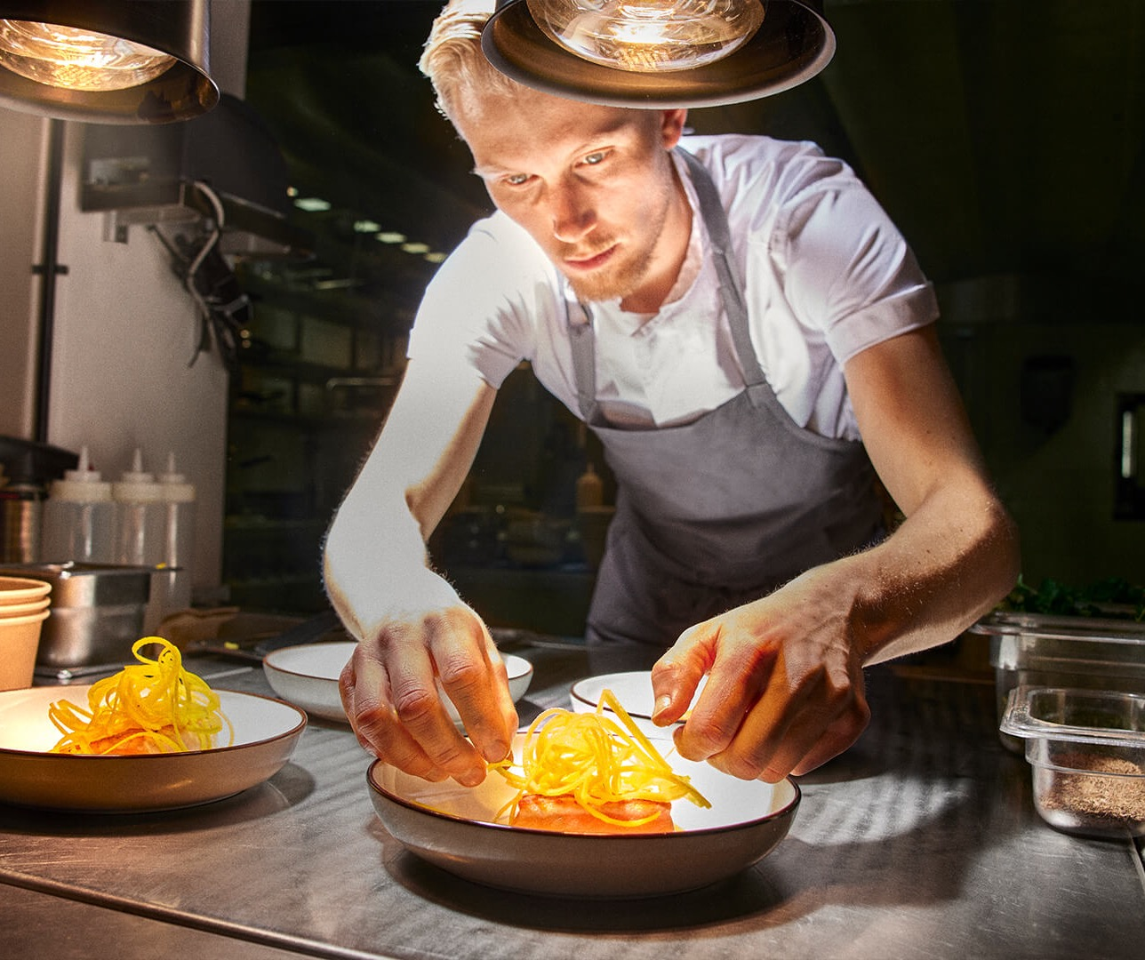

Agenda
Highlights
Market outlook
Q1 summary
Business areas
Innovations
Sustainability
Financials
Summary
Q&A
3

Slide 4

Highlights
Improved operating income, being the highest first quarter measured.
Gross profit increased by 11.2% compared to the same period previous year.
Continued expansion in food packaging with strategically niched acquisitions.
4

Slide 5
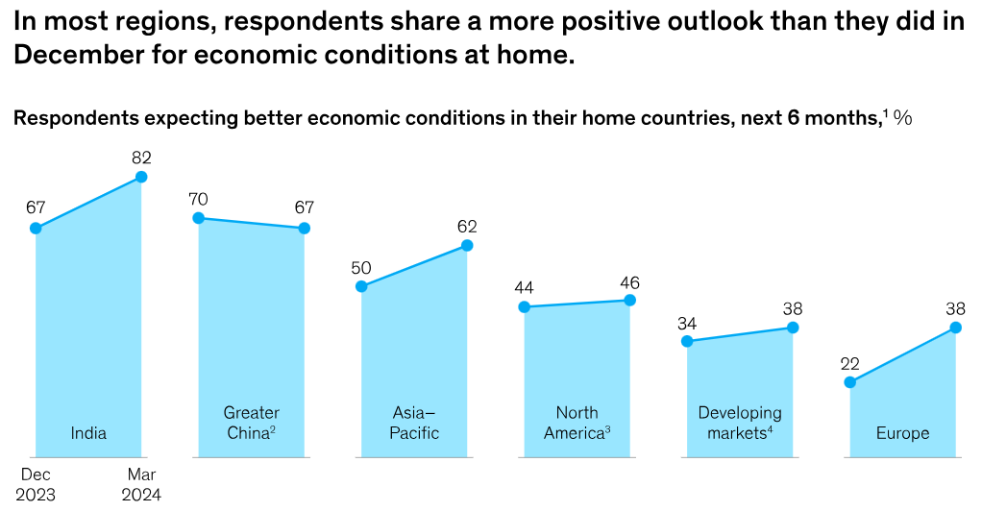
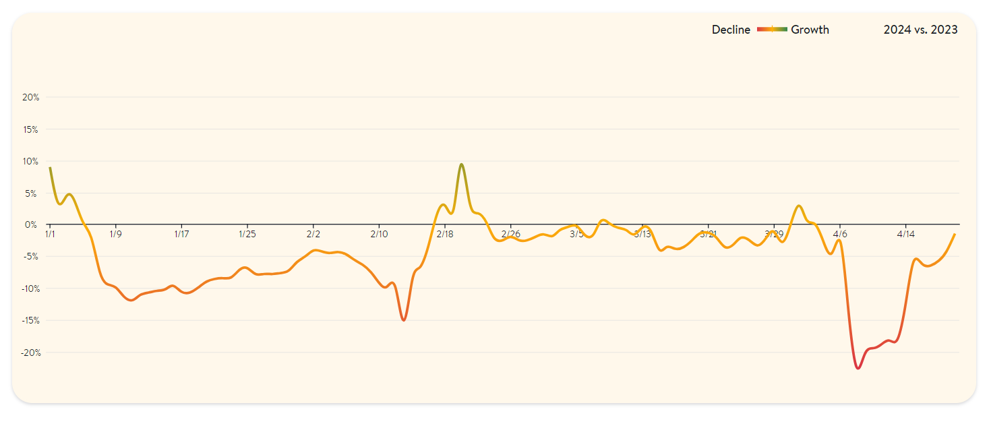
Market Outlook
The HoReCa market will continue to have a gradual and potentially volatile recovery short-term and a stable recovery long-term. Mixed signals and uncertainty for the coming quarters.
Duni Group’s complementary business areas with a diversified product portfolio provides resilience.
The Group’s good financial position enables addressing profitable long-term growth opportunities.
2019
2020
2021
2022
2023
2024
* in% vs 2019 (only 2019 vs 2018)
Source: NPD, part of Crest
*Data for Germany
Source: McKinsey
Source: https://www.opentable.com/state-of-industry
*Data for Germany

Slide 6

Q1 2024
Key Financials
SEK 1,736 m
NET SALES
OPERATING INCOME
OPERATING MARGIN
SEK 140 m
8.1%
Net sales amounted to
SEK 1,736 m (1,877)
Operating income amounted to
SEK 140 m (130)
Operating margin was
8.1% (6.9)

Slide 7
Q1 Comments
NET SALES -7.5%
OPERATING INCOME +7.6%
Market data indicates a softer Q1 compared to last year
Partial price decreases effective from beginning of the quarter
Sales through Retail in United Kingdom and Germany behind significant share of the volume decrease
Fewer invoicing days has negative phasing impact
In the quarter acquired Relevo and Huskee, while already acquired Decent Packaging was consolidated in February and Relevo in March. Huskee will be as from 1st of April
Improved price and cost balance for raw material and sea freight compared to same period previous year
Lower cost for stock keeping as levels have normalized after the pandemic peak
Customer mix improved with higher share towards HoReCa compared to same period previous year
Indirect costs increased due to investments in digital transformation, innovation and market expansions outside of Europe

Slide 8

BA Dining Solutions
NET SALES
OPERATING INCOME
OPERATING MARGIN
SEK 1,030 m
SEK 109 m
10.6%
Net sales amounted to
SEK 1,030 m (1,130)
Operating income amounted to
SEK 109 m (122)
Operating margin was
10.6% (10.8)

Slide 9
Dining Solutions Q1 2024
General decrease in demand from HoReCa market
Sales towards Retail decreased significantly for a few larger volume contracts in the UK and Germany
Price decreases effective from the start of the year further lowered the turnover, but secured relevance in tender business
Lower volumes means less fixed cost coverage in the vertically integrated factories
Improved price and cost balance together with efficiency improvements in manufacturing strengthens the result

Slide 10
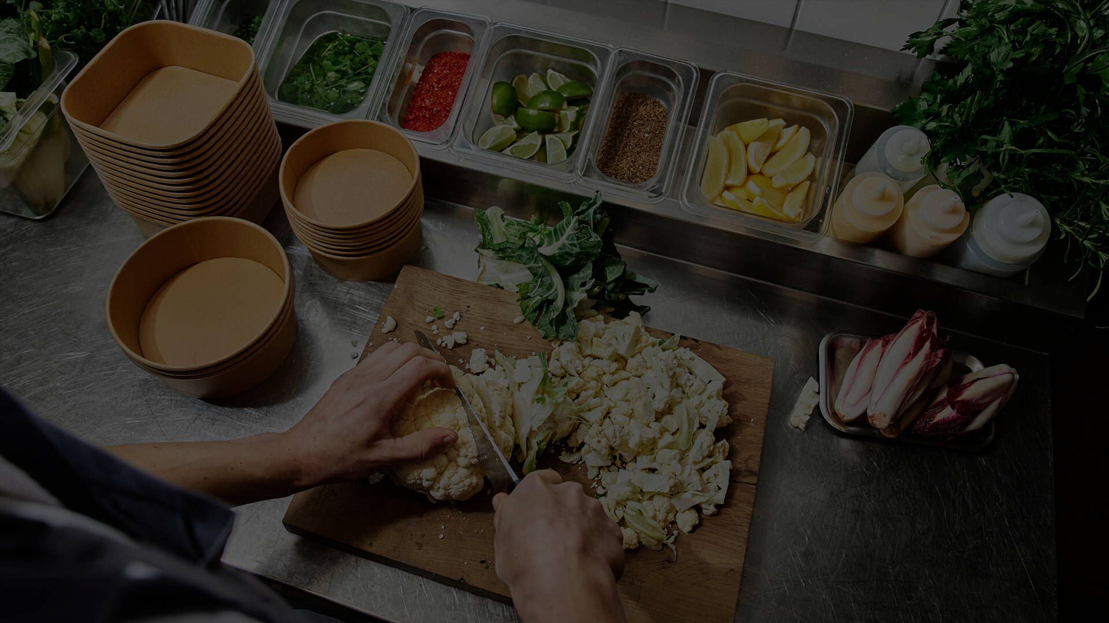
BA Food Packaging Solutions
NET SALES
OPERATING INCOME
OPERATING MARGIN
SEK 705 m
SEK 30 m
4.3%
Net Sales amounted to
SEK 705 m (747)
Operating Income
SEK 30 m (8)
Operating Margin was
4.3% (1.1)

Slide 11
Food Packaging Solutions Q1 2024
Price decreases to reflect lower sea freight cost explain significant part of the lower sales
Volume growth outside of Europe while volumes in Europe as demand weakens
In line with Dining Solutions volume decreases towards Retail in UK and Germany
Operating Income improved derived from lower inventory and cost of sea freight normalized

Slide 12

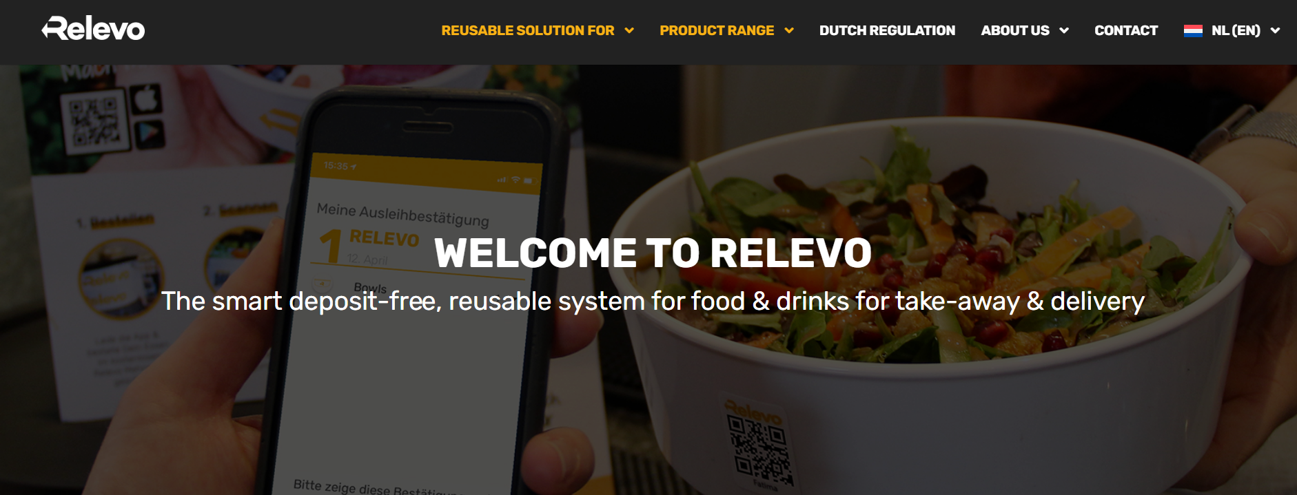
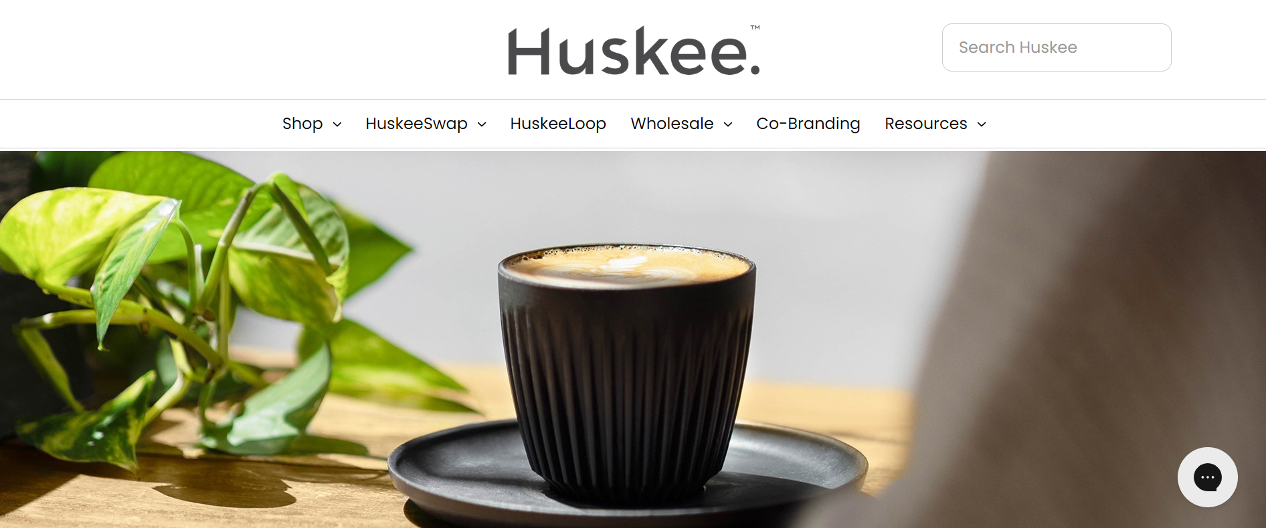
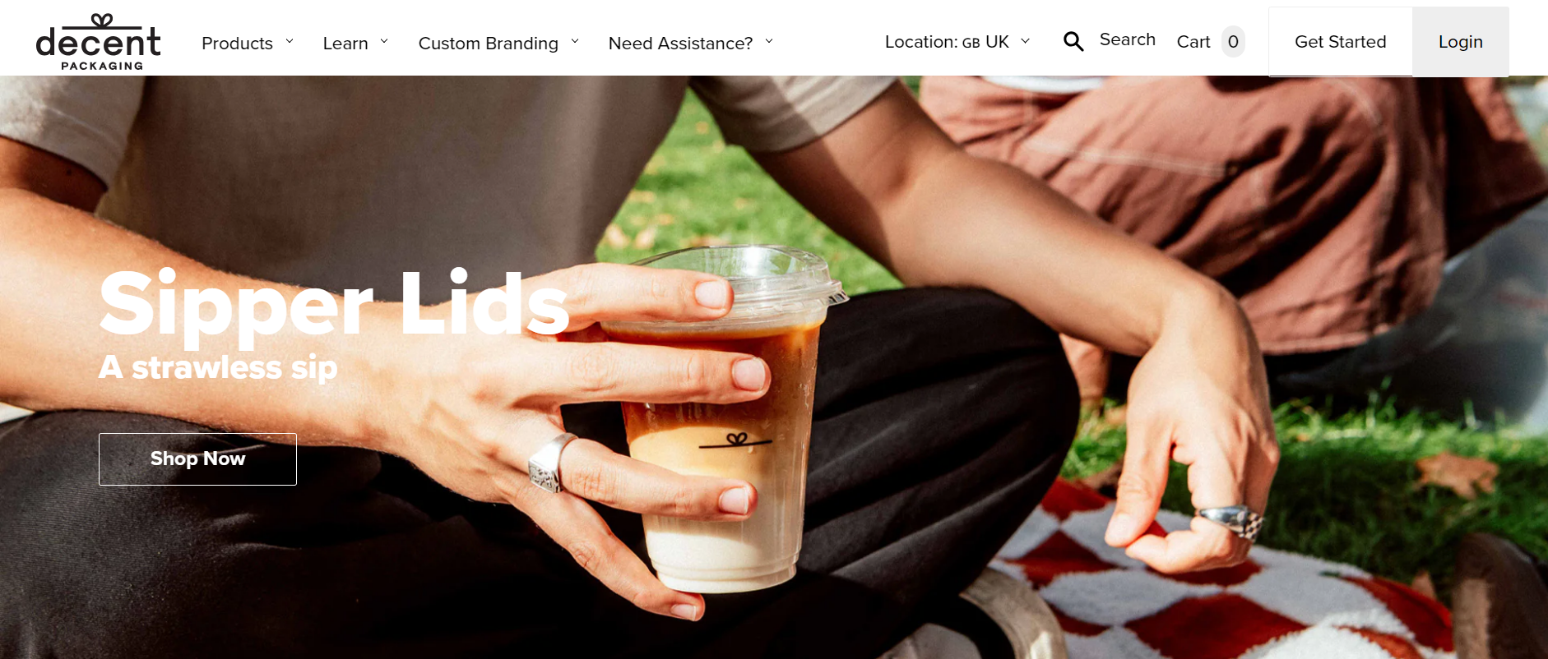
Acquisitions
In the quarter acquired Relevo (majority share) and Huskee
Already acquired Decent Packaging was consolidated in February, Relevo in March and Huskee to be consolidated from April
All companies are consolidated within the Food Packaging Solution business area and Decent Packaging and Huskee also within BioPak Group
Relevo is a startup and Decent Packaging and Huskee together have annual net sales of approximately SEK 200 m with profitability in line with Duni Group
Financing for Decent Packaging and Huskee take place within the existing BioPak Group loan facility and by BioPak Group shares
12

Slide 13

Trusted Sustainability Leader in our Industry
Engaging in sustainable innovations predominantly within Circularity
LAB
COOPERATIONS
PARTNERSHIPS
STARTUP PROJECTS
(minority investments)
Bio Dunisoft®
OrganoClick
Bûmerang
Idun
Bio Dunicel®
Bower
Relevo
BicyCompost
Unmo
Notpla

Slide 14

Our Decade of Action 2030
Our sustainability initiatives
BECOMING CIRCULAR AT SCALE
GOING NET ZERO
LIVING THE CHANGE
100%
0 CO2
#1
Circular target
Net Zero carbon emissions for
Scope 1 and 2
A trusted sustainability leader

Slide 15

Becoming Circular at Scale
Going Net Zero
Living the Change
ACTIVIES IN THE QUARTER
ACTIVIES IN THE QUARTER
ACTIVIES IN THE QUARTER
Collaboration with Notpla for plastic-free packaging
Acquisitions within sustainable and innovative food packaging solutions which use material from residual waste or offer solutions for reuse
Energy audits started in European factories
Scope 3 reporting for 2023 completed
EcoVadis result for 2023: 77 points, top 2% in industry
E-learning for whistleblowing
Use of virgin fossil plastic for
single-use items
KPI: Reduction by 50% by 2025 compared to 2019 as a base year
Progress: Fossil plastic use index at 65 for Q1 2024 (reduction by 35%)
Scope 1+2 carbon intensity
KPI: Reach index 38 by end of 2024 compared to 2019 as base year
Progress: Carbon intensity reached index 44 by the end of Q1 2024
Ecovadis score:
KPI: EcoVadis Platinum level by 2025 (full-year result)
Progress: EcoVadis score 77 (top 2%) for 2023 (Gold level)
15

Slide 16

Financials

Slide 17
Income Statement
SEK m | Q1 / 2024 | Q1 / 2023 | LTM / 2023-24 | FY / 2023
Net sales | 1,736 | 1,877 | 7,577 | 7,718
Gross profit | 435 | 391 | 1,890 | 1,846
Gross margin | 25.1% | 20.9% | 24.9% | 23.9%
Selling expenses | -188 | -161 | -725 | -699
Administrative expenses | -102 | -95 | -427 | -421
R & D expenses | -9 | -6 | -39 | -36
Other operating net | -14 | -17 | -39 | -42
EBIT | 123 | 111 | 659 | 648
Adjustments | -17 | -19 | -67 | -68
Operating income¹⁾ | 140 | 130 | 726 | 716
Operating margin | 8.1% | 6.9% | 9.6% | 9.3%
Financial net | -13 | -18 | -51 | -56
Taxes | -26 | -3 | -173 | -150
Net income | 83 | 90 | 436 | 443
Earnings per share, attributable to equity holders of the Parent Company | 1.66 | 1.65 | 8.31 | 8.30
¹⁾ Operating income adjusted for fair value allocations and amortization of intangible assets identified in connection with business acquisitions and for restructuring costs.

Slide 18
Business Area Financials
SEK m |  | Q1 / 2024 | Q1 / 2023 | LTM / 2023-24 | FY / 2023
Dining Solutions | Net sales Operating income¹⁾ Operating margin | 1,030 109 10.6% | 1,130 122 10.8% | 4,581 587 12.8% | 4,681 600 12.8%
Food Packaging Solutions | Net sales Operating income¹⁾ Operating margin | 705 30 4.3% | 747 8 1.1% | 2,996 139 4.6% | 3,037 117 3.8%
Duni Group | Net sales Operating income¹⁾ Operating margin | 1,736 140 8.1% | 1,877 130 6.9% | 7,577 726 9.6% | 7,718 716 9.3%
¹⁾ Operating income adjusted for fair value allocations and amortization of intangible assets identified in connection with business acquisitions and for restructuring costs.

Slide 19
Operating Cash Flow
SEK m | Q1 / 2024 | Q1 / 2023 | LTM / 2023-24 | FY / 2023
Operating EBITDA¹⁾ | 174 | 162 | 871 | 860
Capital expenditure | -26 | -19 | -162 | -157
Change in;
Inventory | -94 | 153 | 222 | 469
Accounts receivable | 39 | -54 | 98 | 5
Accounts payable | -136 | -219 | -37 | -120
Other operating working capital | -81 | -2 | 21 | 101
Change in working capital | -273 | -122 | 305 | 456
Operating cash flow²⁾ | -124 | 21 | 1,014 | 1,158
¹⁾ Operating EBITDA is EBITDA less restructuring costs and fair value allocations and effects from IFRS 16 Leases.
²⁾ Operating cash flow excludes changes in right-of-use assets and changes in leasing debts.

Slide 20
Financial Position
SEK m | March 2024 | December 2023 | March 2023
Goodwill | 2,263 | 2,110 | 2,126
Tangible and intangible fixed assets | 1,575 | 1,500 | 1,522
Net financial assets¹⁾ | -19 | -36 | -15
Inventories | 1,430 | 1,251 | 1,578
Accounts receivable | 1,137 | 1,125 | 1,196
Accounts payable | -615 | -719 | -623
Other operating assets and liabilities³⁾ | -622 | -651 | -530
Net assets | 5,150 | 4,580 | 5,254
Net debt | 921 | 598 | 1,444
Equity | 4,229 | 3,982 | 3,810
Equity and net debt | 5,150 | 4,580 | 5,254
ROCE²⁾ | 15% | 16% | 11%
ROCE²⁾ w/o Goodwill | 27% | 32% | 18%
Net debt / Equity | 22% | 15% | 38%
Net debt / EBITDA²⁾ | 0.98 | 0.65 | 1.96
¹⁾ Deferred tax assets and liabilities + Income tax receivables and payables.
²⁾ Operating income adjusted for fair value allocations and amortization of intangible assets identified in connection with business acquisitions and for restructuring costs. Calculated based on the last twelve months.
³⁾ Including restructuring provision and derivatives.

Slide 21
Financial Targets
SALES GROWTH
OPERATING MARGIN
DIVIDEND PAYOUT RATIO
> 5%
> 10%
40+%
Organic growth of 5% over a business cycle
Consider acquisitions to reach new markets or to strengthen current market positions.
Top line growth – premium focus
Improvements in manufacturing, sourcing and logistics.
Target at least 40% of net profit
LTM 2023/24
LTM 2023/24
2023
-2.0% at fixed exchange rates
9.6%
5.00 SEK (60%)

Slide 22

Summary Q1 2024
Market data indicates a softer Q1 compared to last year, reflected in net sales
Improved operating income, being the highest first quarter measured
Gross profit increased by 11.2% compared to the same period previous year
Continued expansion in food packaging with strategically niched acquisitions
Continued strong financial position
22

Slide 23

Thank you!

